Slide 1
Hubot
Young Liu, Yun Ma, Xuzhou Yin, Xiao Liang

Slide 2
Overview
Project Process
Potential Risk
Our Schedule

Slide 3
What we achieved😯
Jira is not possible to access.
Our project should base on the information of NetJets.
Skype Business is new to us.
Slack is another choice.
Api.Ai is not a good option
It’s not open sourced, it’s commercial. It does not match security standard of NetJets
A very simple demo using Hubot.
Next slide
Microsoft Bot Framework is more powerful
We should switch to it before it’s too late
Demo after Hubot Demo

Slide 4
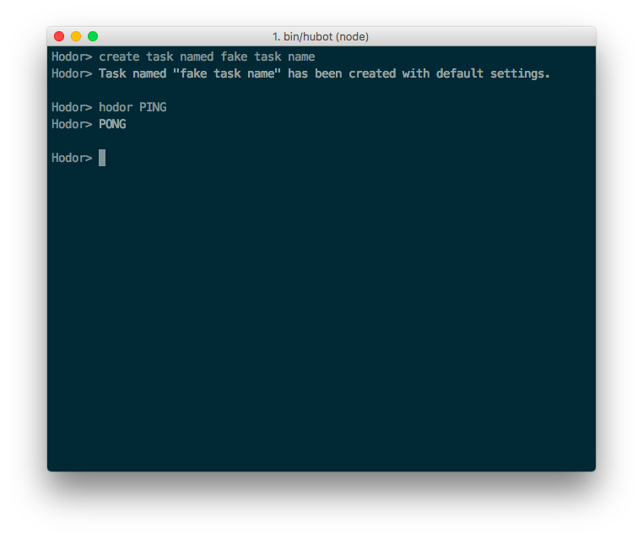
Hubot Demo

Slide 5
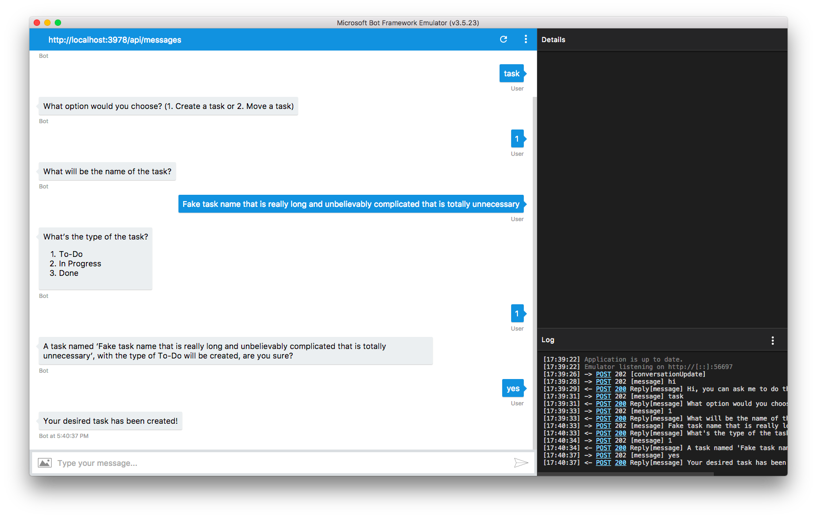
Microsoft Bot Framework Demo

Slide 6
What we achieved (cont.)
5. Trello board using Hubot
6. Integreate with either Slack or Skype
7. Start exploring with Jira

Slide 7
Risk
The team still could not come up with a time slot that everyone is available for team meeting
The team needs to do more research on the APIs of the choices it has (Skype for business, Jira) and get more familiar with them
The team needs more time to discuss about the role of each person for this project
Transforming from Trello to Jira will introduce some uncertainty and risk.
The team hasn’t figured out how to integrate voice recognition into chat module.
Haven’t built a full test plan for current module and functionality we have.

Slide 8
Plan Schedule
Weekly meetings with sponsor (Tuesday)
discuss the problem: Jira, Trello
talk about our future plan (Luis, the Natural Language Processing tool, etc.)
feedback and advice
Team meeting
talk about the features needed
build the plan schedule for future
set up roles for each position
Documentation
meetings
addition ideas

Slide 9
Thanks!

